Slide 1
Cyclist Membership Case Study
Profile differences between annual and casual usage and potential targeted marketing strategies.

Slide 2
Executive Summary
Objective
Usage Profiles
Strategies
Understand the difference in usage for annual members and casual users in order to identify possibilities of converting casual users to annual subscriptions.
Findings:
Members have a much smaller average trip time.
Casual users greatly increase their usage during the weekend.
Create a weekend usage tailored annual plan.
Reduce membership entry friction in order to cater for more menial and shorter trip usage.
Direct marketing efforts to lure weekend users.

Slide 3
Findings

Slide 4
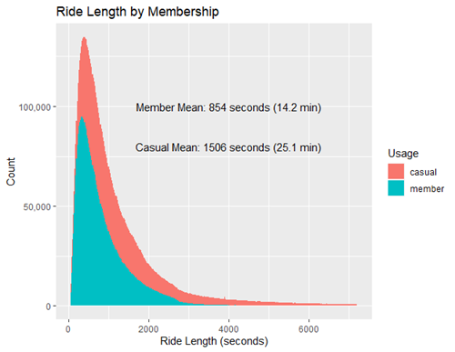
Average Ride Time by Membership
Comparison between average trip duration for members and casuals.
Average trip duration for casual users is 76% greater than annual subscription members.
Member users tend to have a larger number or menial trips while casual users want greater utility when opting for their trips.

Slide 5
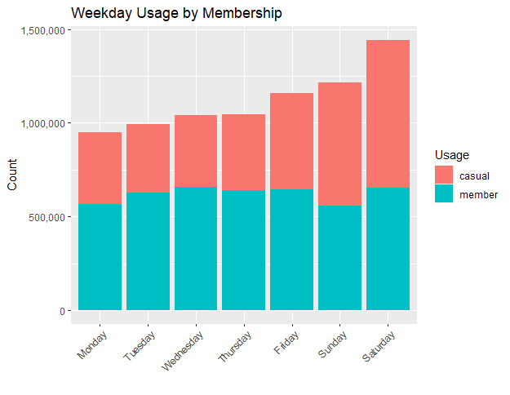
Weekday Usage by Membership
Comparison between trip count for members and casuals during the week.
Consistent trip count during week for annual memberships.
Spike in usage for casual members during weekends.
Increase in weekend usage is almost entirely due to casual usage.

Slide 6
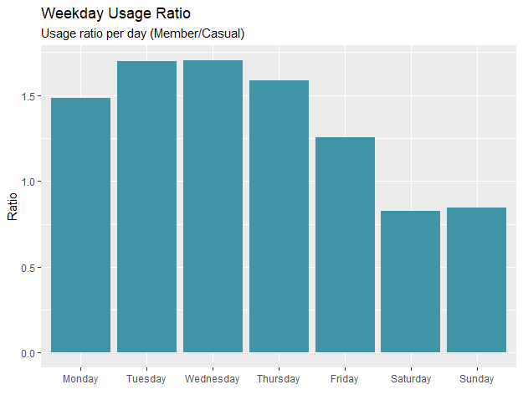
Membership Ratio During the Week
Ratio between annual memberships and casual usage for each week day.
Saturday and Sunday ratios clearly show the need for a clear user profile restricted for weekend usage.
Current plan favors a more utilitarian usage during the week, for example work or school trips.
Weekend usage implies a more enjoyment focused use.

Slide 7
Strategies

Slide 8
Recommendations
Weekend Plan
Short Trip Friction
Weekend Targeting
Create a tailored annual plan that targets weekend users.
Usage during weekends included and discount for week day trips.
Further investigate friction for short trip usage.
Improve the ease of membership subscription for when the user wants to make short trips.
Focus marketing efforts on weekend users.
Locate most common weekend starting stations and introduce targeted ads.
Tailor messages for more leisure usage.

